Slide 1

ML
Menu
About Us
@reallygreatsite
MOBILES
ANALYSIS
ML PROJECT

Slide 2
ML
Mahmoud Ashery Mahmoud
2302594
Section 8
Menu
About Us
@reallygreatsite
Moaz Mohamed Mahmoud
2302596
Section 8
This
Project
Created
By:
Sohila Abdelnasser Mohamed
2300255
Section 2
Alyaa Hesham Ismail
2302807
Section 8
Jumana Hazim Salah Elden
2300232
Section 1
Fatma Elzahraa Mohamed Ahmed
2300281
Section 2
Under Supervision : DR Mayar Aly

Slide 3

ML
Menu
About Us
@reallygreatsite
In this project,
we aimed to develop a model that predicts mobile phone prices based on feature such as RAM across USA The dataset contains information about various mobile phones available in multiple international markets.
We began with the basic steps like data cleaning, where we removed invalid values, imputed missing values, and handled outliers. Then, we moved to the next step of modeling using algorithms like Random Forest. Finally, we evaluated the models using several metrics such as Root Mean Squared Error (RMSE), Mean Absolute Error (MAE), and R² score.

Slide 4


ML
Menu
About Us
@reallygreatsite
Dataset Details:
The dataset used in this project contains various details about mobile phones launched in USA. The data includes variables such as:
RAM: Refers to the amount of random-access memory in the mobile phone.
Launched Price in USA: The price at which the phone was launched in USA

Slide 5

ML
Menu
About Us
@reallygreatsite
Data Size:
The dataset consists of multiple records representing different mobile phones, with some columns containing missing or invalid data.
Goal of the Dataset:
The primary goal is to use this data to build a model that predicts mobile phone prices based on technical specifications (like RAM.).

Slide 6
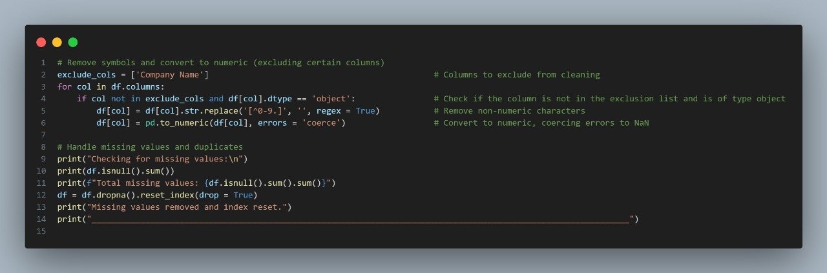
Menu
About Us
@reallygreatsite
ML
Missing Values Analysis:
Data Cleaning:
We checked for missing values across all columns using .isnull().sum().
Columns with missing values were carefully inspected.
Rows with missing critical values (especially in RAM and Launched Price) were removed to maintain data integrity.
Non-Numeric Characters: Some columns had unwanted characters (like currency signs), so we cleaned them using regular expressions (str.replace('[^0-9.]', '', regex=True)).
Conversion to Numeric: After cleaning, we converted these columns to numeric types using pd.to_numeric().

Slide 7
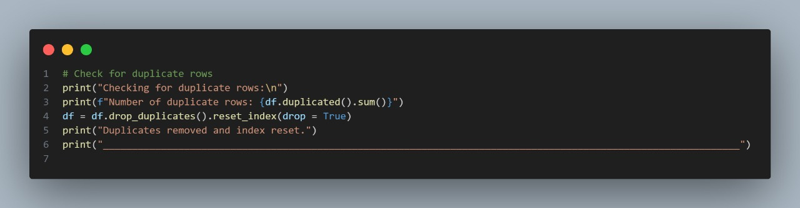
ML
Menu
About Us
@reallygreatsite
Duplicate Records:
We used .duplicated().sum() to check for duplicate rows.
Duplicate entries were found and removed to prevent bias in model training.

Slide 8
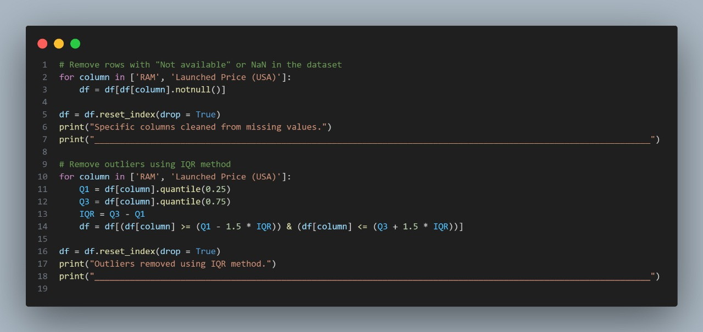
Menu
About Us
ML
@reallygreatsite
Outlier Detection and Removal:
Interquartile Range (IQR) Method:
We calculated Q1 (25th percentile) and Q3 (75th percentile).
Outliers were identified as points lying below Q1 - 1.5*IQR or above Q3 + 1.5*IQR.
We applied this method particularly on key features like RAM and Launched Price (USA).
Z-Score Method:
We calculated the Z-score for the price data.
Any record with a Z-score greater than 3 (or less than -3) was flagged as an outlier.

Slide 9
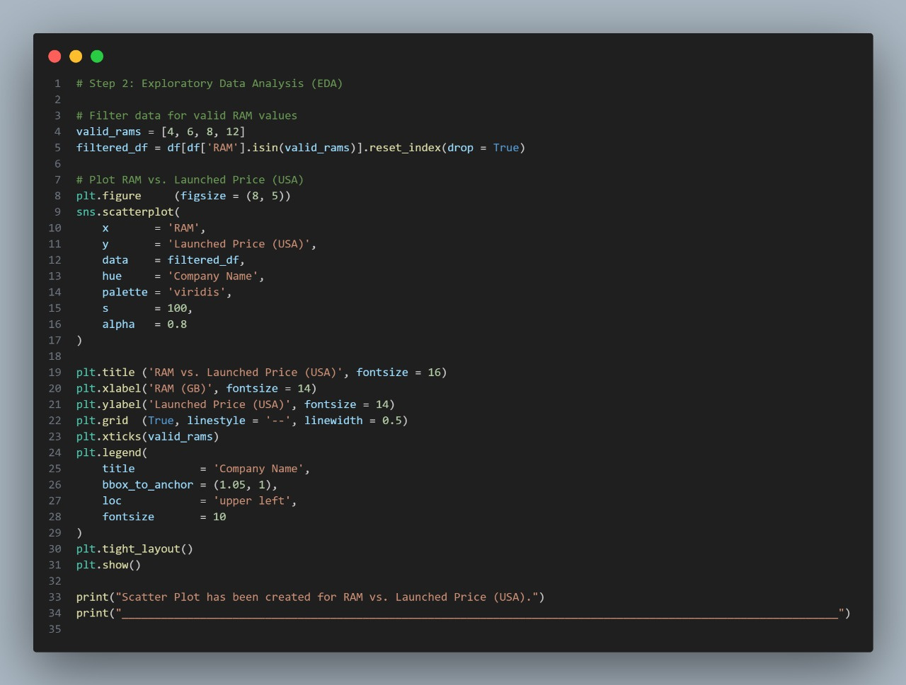
ML
Menu
About Us
@reallygreatsite
Data Visualization:
Scatter Plot:
We created scatter plots of RAM vs. Launched Price (USA).
Different colors were used for different companies to visually inspect how the RAM affects the price for various brands.
Observations from the Scatter Plot:
Clear trend: Higher RAM generally corresponded to higher launch prices.
Some brands offered more RAM at relatively lower prices, revealing market segmentation strategies.

Slide 10
ML
Menu
About Us
@reallygreatsite
Data Visualization:
Summary of EDA Findings:
The dataset contained missing values and duplicates that needed to be cleaned.
Outliers in RAM and Price were present and were removed.
After cleaning, the relationship between RAM and Launched Price became clearer.
Company names and RAM were found to be significant factors influencing the price.
EDA confirmed that the data was ready for modeling with minimal assumptions violated.

Slide 11
ML
Menu
About Us
@reallygreatsite
Data Visualization:
📊 Why EDA Was Important:
It improved the quality of data and ensured that the models trained would be reliable.
Helped in choosing the best features and appropriate preprocessing steps.
Allowed detection of potential errors and inconsistencies early in the project

Slide 12
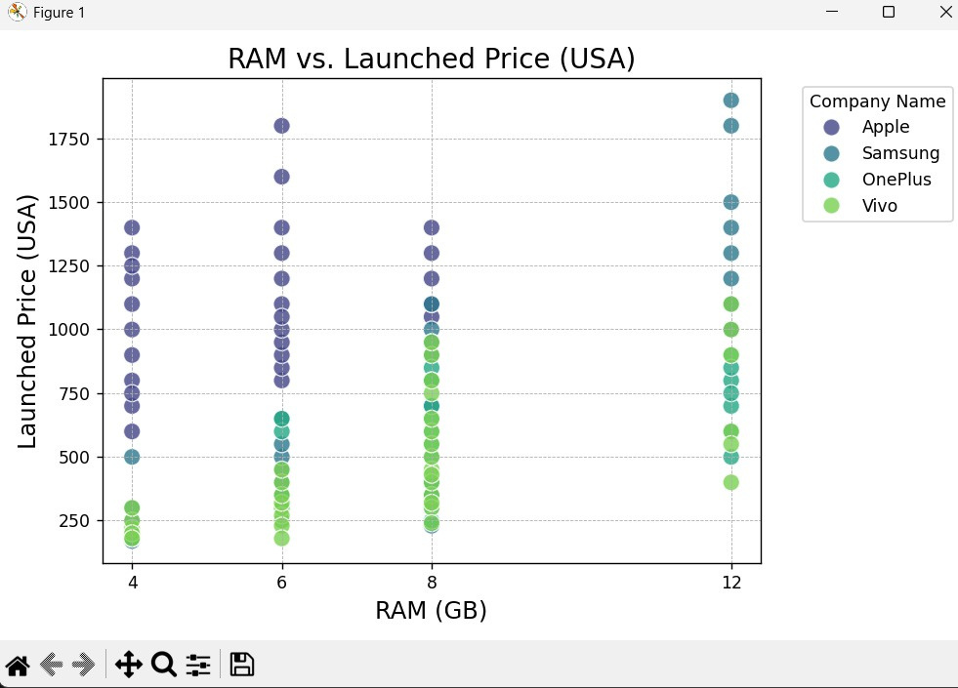
ML
Menu
About Us
@reallygreatsite
What is a Scatter Plot?
A Scatter Plot is a graph used to show the relationship between two variables.
Each point on the graph represents a data record, with its position determined by the values on the x-axis and y-axis.
In your case, you're using the Scatter Plot to visualize the relationship between RAM and Launched Price in the USA.
Plot Details:
X-axis: Represents RAM.
Y-axis: Represents Launched Price (USA).
Points: Each point represents a mobile phone, where its position is determined by the RAM and the price.
Colors: Represent Company Name, with each company having a different color, helping to compare prices across different companies.
Why Use a Scatter Plot?
To compare how RAM affects Price. For example, does a higher RAM correspond to a higher price?
To discover relationships or patterns between the variables.

Slide 13
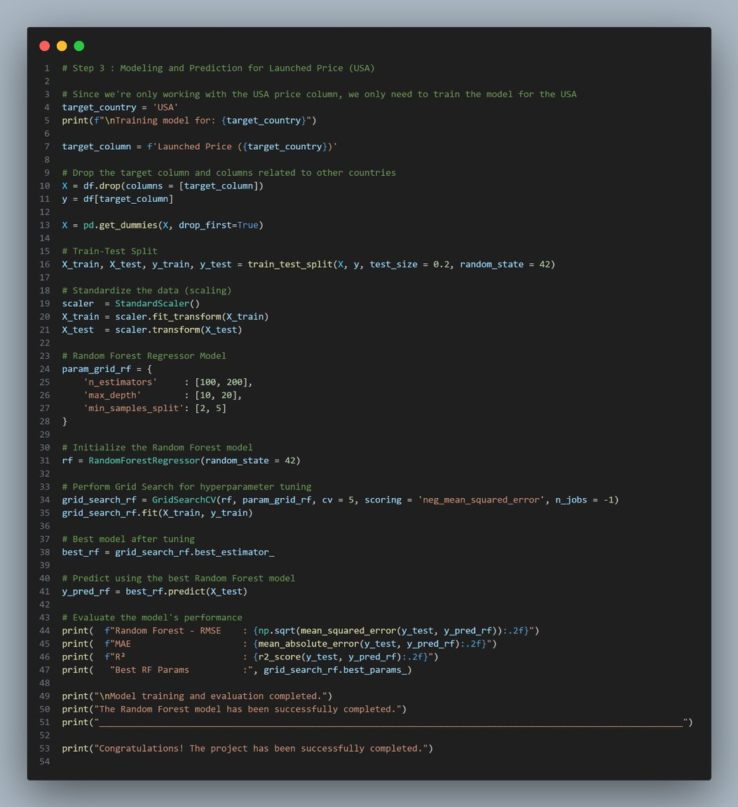
ML
Menu
About Us
@reallygreatsite
Modeling and Prediction:
Splitting the Data into Training and Testing Sets:
Used train_test_split() to divide the data into training and testing
sets (80% training, 20% testing).
Random Forest Model: We used the Random Forest Regressor to build the prediction model for mobile phone prices.
Grid Search CV for Hyperparameter Tuning: We performed Grid
Search CV to find the best hyperparameters for the Random
Forest model.
Model Selection: We selected the best model based on the
hyperparameters found through cross-validation.

Slide 14
ML
Menu
About Us
@reallygreatsite
Model Evaluation:
The model was evaluated using performance metrics such as:
Root Mean Squared Error (RMSE): To measure the error in predictions.
Mean Absolute Error (MAE): To measure the average absolute error.
R² score: To assess how well the model predicts the data.

Slide 15


ML
Menu
About Us
@reallygreatsite
conclusion
In this project, we successfully developed a model to predict mobile phone prices using various modeling techniques. Through data cleaning and transformation, removing missing values, handling outliers, and using Random Forest with GridSearchCV for hyperparameter tuning, we were able to improve the accuracy of our model.
Although the model performed well, there is always room for improvement by incorporating additional features or using more advanced techniques. In the future, we could enhance the model by adding more data such as user reviews or images of the phones to improve the prediction accuracy.

Slide 16
ML
Menu
About Us
@reallygreatsite
thank you

